Slide 1

HOTEL MANGEMENT SYSTEM
PROJECT GUIDE SUBMITTED BY
Mrs.Indrakka Malli M.Niranjana
D.Pavithra
Kirannya gaddam
K.Nivetha

Slide 2

CONTENTS
Introduction
Objective
System view
Modules
Requirement
Annotation
Databases and Tables
Conclusion

Slide 3

INTRODUCTION
The project Hotel Management System is developed by Spring Boot framework. It has the ability to manage hotel booking . Where we can see the hotel details like hotel address , hotel name , hotel address .The customer details like name , phone number were collected from the customer in order to book a room . The Hotel handles the entire customer details . Admin can able to insert , update , delete customer details. This application gives flexibility to manage the entire system.

Slide 4
OBJECTIVE
To design a software to for performing basic operation done in hotel .
To create a flexibility while handling the records.
Focus on friendly user control.
Easy adding and removing content.

Slide 5
SYSTEM VIEW
There is no need for paper pen work.
Everyone can able to function this.
Customer details will be safe no one can access or see the customer details.
When wrong details or irrelevant details are given it shows the Error message.

Slide 6
MODULES Hotel Modules
We can able to get hotel by its id .
We can check the customer details by entering the code of the hotel.
Can able to fetch Hotel by hotel name ,hotel address, hotel phone number , hotel code.

Slide 7

CUSTOMER MODULE
Can fetch all customer details .
Can able to fetch single customer details by their ID.
Can fetch the customer old record .
Can able to delete details of the customer if not needed.
Can able to update details or make change after recorded.

Slide 8
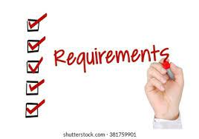

Slide 9
SOFTWARE REQUIREMENT
DATA BASE : MySQL
API- Spring Data JPA ,spring web, spring .
TOOLS : postman , IDE – Spring Tool Suite 4.
CODING TOOLS : Java 1.8

Slide 10
HARDWARE REQUIREMENT
RAM : 8 GB
PROCESSOR: 64Bit OS
MEMORY : 700 mb
DISK SPACE : 1TB

Slide 11

ANNOTATIONS
1. @ Entity 10 . @ Repository
2. @ Tables 11. @Autowired
3. @ Id 12 . @RestController
4. @NotNull 13 . @GetMapping
5. @ NotBlank 14. @PostMapping
6. @Length 15 . @ DeleteMapping
7. @Service 16. @PutMapping
8. @Generatedvalues 17 . @ SequenceGenerator
9.@ join column 18 . @OnetoMany

Slide 12
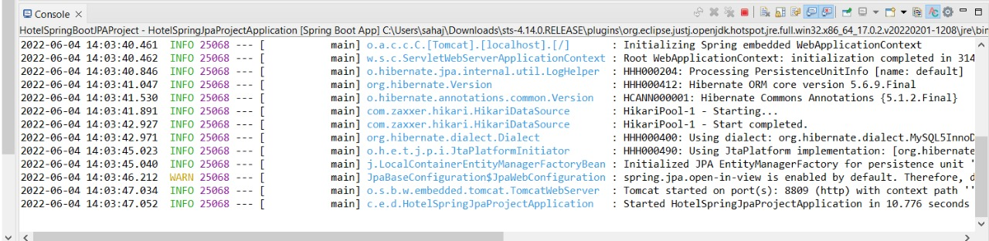
OUTPUT

Slide 13
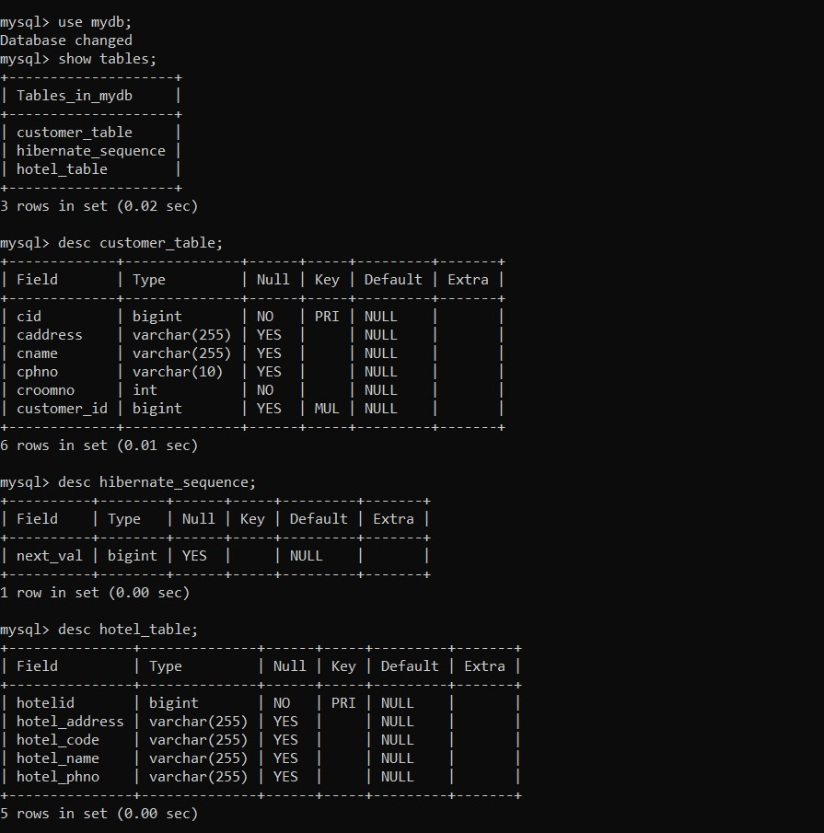

Slide 14
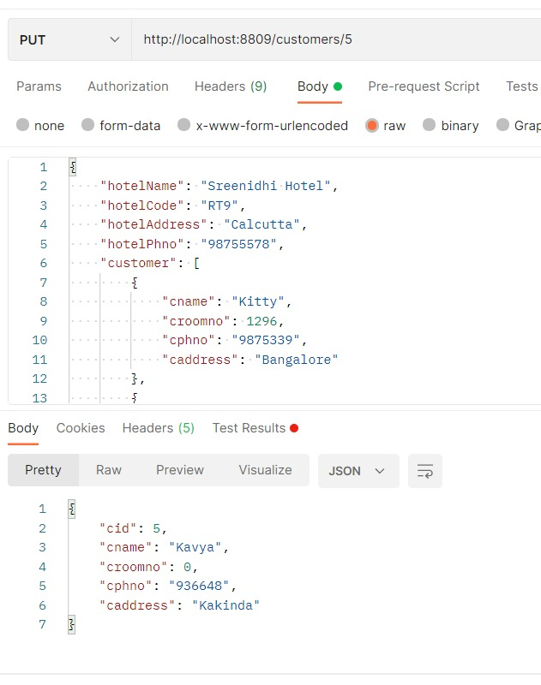
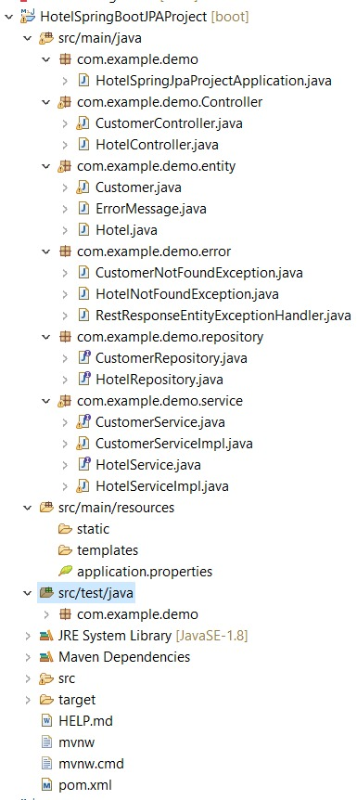

Slide 15
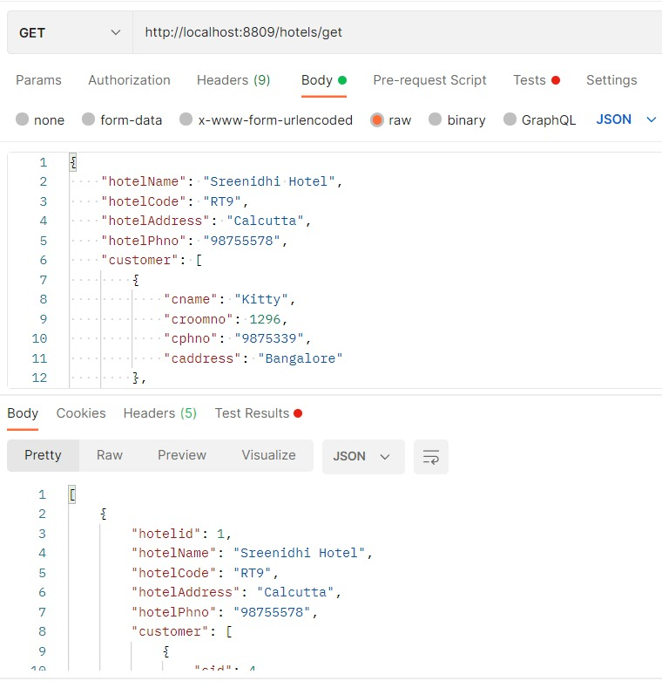

Slide 16
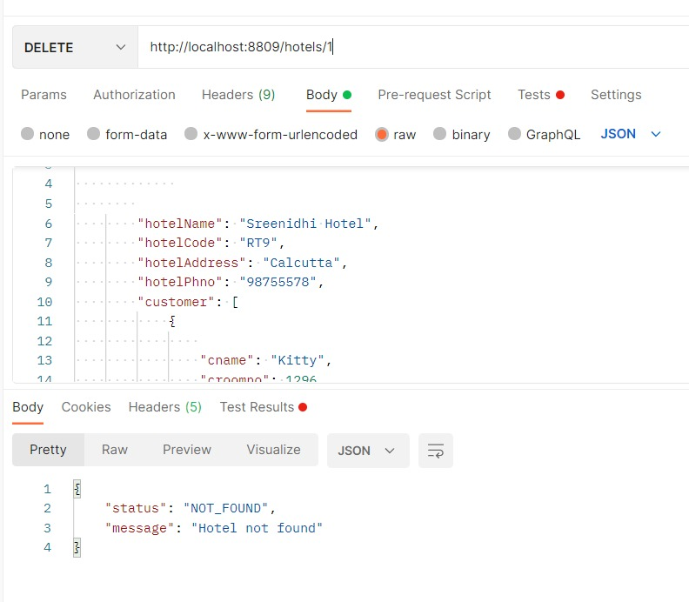
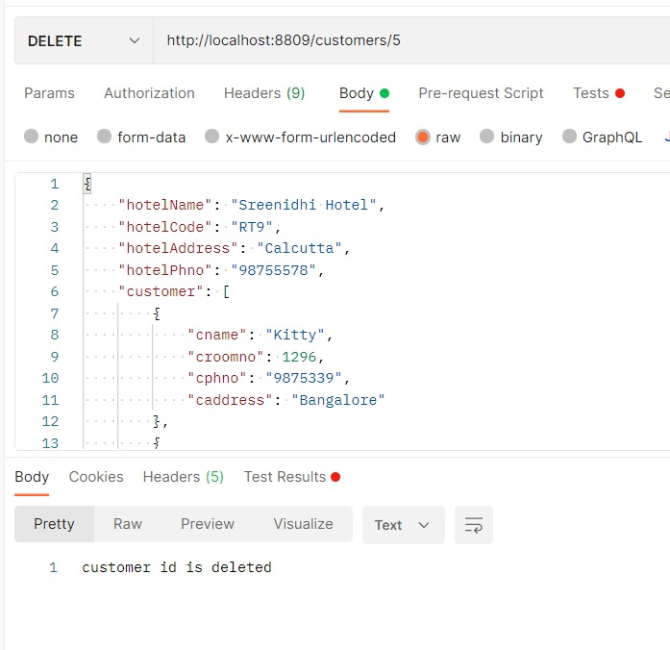

Slide 17
CONCLUSION
The Hotel management system designed for doing simple operations efficiently and securely . It is used for finding Hotels , available rooms , customer information , updating and inserting data specifically selecting without affecting other data by ID .

Slide 18
THANK YOU…!!!!

